Slide 1
How Many of You Played With LEGO bricks as a kid?
Notes:
Hannah

Slide 2
The LEGO Group
Kacie Borowicz, Amanda Gorecki, Hannah Johnson, Charlotte Sonterre
Notes:
All

Slide 3
Introduction to The LEGO Group - Fast Facts!
Mission Statement: “Inspire and develop the builders of tomorrow.”
Values: Imagination, fun, creativity, caring, learning, and quality
Vision: “A global force for Learning-through-Play.”
Belief: “Children are our role models.”
Notes:
Hannah
the introduction should introduce the company you selected. You should tell us a little about the company and pull from the company profile you completed. You should state what social media presence the company currently has. You should introduce each member of the group.

Slide 4
Introduction to The LEGO Group - Important Dates
Founded in 1932 in Denmark
The company started with wood toys!
The first plastic bricks were made in 1949 because of supply issues with wood after WWII
The very first LEGOLAND park opened in Denmark in 1968
The first North American LEGO facility opened in Connecticut in 1975
LEGO Canada was established in 1988
The first LEGO video game; LEGO Island, released in 1995
1999 saw the first licensed LEGO sets - Star Wars was among them!
LEGOLAND opened in Carlsbad, California in 1999
The LEGO Movie released in 2014, grossing $470 million on a budget of $65 million
Notes:
Kacie
the introduction should introduce the company you selected. You should tell us a little about the company and pull from the company profile you completed. You should state what social media presence the company currently has. You should introduce each member of the group.

Slide 5
Current Social Media Presence
Facebook
Posts daily
Nearly 15 million followers
Uses the same texts and images as Instagram posts
Instagram
Daily Posts
Creates hashtags and encourages the community to use them
Lots of content curated from the community
7.7 million followers
Often features collaborations with actors who are seen in LEGO sets from movies and shows
Twitter
Very interactive
Memes, images and videos
Nearly 870,000 followers
YouTube
Multiple videos a day shown in multiple languages
Tips and tricks videos
YouTube Shorts
13.7 million subscribers
Notes:
-Kacie
-Hannah
-Amanda
-Charlotte
the introduction should introduce the company you selected. You should tell us a little about the company and pull from the company profile you completed. You should state what social media presence the company currently has. You should introduce each member of the group.

Slide 6
Current Social Media Presence
Pinterest
Posts roughly twice a week
Has their own boards and shares boards from others in the community
Great resource for parents!
245,000 followers
LinkedIn
Posts around twice a week
Photos, videos, some articles
Posts primarily show LEGO’s company culture
884,000 followers
Notes:
-Kacie
-Hannah
the introduction should introduce the company you selected. You should tell us a little about the company and pull from the company profile you completed. You should state what social media presence the company currently has. You should introduce each member of the group.

Slide 7
SWOT: Strengths And Weaknesses
Strengths: The fact that LEGOs are a product that appeals to a wide age group and many demographics is their strongest advantage. When it comes to social media, their biggest strength is their community, which is a big source of their content in addition to product announcements and launches. The LEGO Group excels at using YouTube and Instagram. On YouTube, they make great use of short-form content including kid-friendly series, behind the scenes videos, building tips and tricks, interviews and more. (In several languages as well, in a nod to worldwide popularity of LEGO.) In their social portfolio, Instagram is their strongest platform. Their posts are always varied, whether they post a singular picture, video, or make use of carousel posts. | Weaknesses: While there are many strengths to the LEGO brand’s social media, there are some areas that are lacking. Looking at posts on Facebook and Twitter. the exact same text and image are used in posts, leaving someone less likely for follow on multiple platforms. The YouTube channel could have greater organization with playlists and keep a closer eye on updating them with a new video is uploaded to the channel. While there’s multiple languages uploaded for the kid-friendly series, there is a lack of accessibility in other videos, as they often rely on YouTube for close captioning (which often does not function well), and for the silent videos with titles in English, there’s no counterpart in another language.
Notes:
Amanda

Slide 8
SWOT: Strengths And Weaknesses
Opportunities: Taking that extra step to make sure Facebook and Twitter posts aren’t carbon copies of each other would be a great start to marking a difference between the two accounts. As for YouTube, it may be best to turn the existing channel into a hub, but also create other YouTube channels for a broader regional reach. Reaching out to different LEGO content creators worldwide would be a great way to launch this strategy. Another opportunity would be to jump into Tik Tok. Just doing a search for LEGO, the platform has a multitude of creators that feature other tips and tricks, building videos, and reviews of LEGO sets. | Threats: Two common threats stand out for The LEGO Group. The first is that stereotype persists that LEGOs are just for boys, or that “cooler” LEGO sets are geared towards boys. (Up until a few years ago, Target used signs that said, “Building Sets,” and “Girls’ Building Sets” while separating LEGOs.) Another threat is public perception of price. There are many LEGO imitators on the market (Construx, and Mega Bloks being the big two) and the pricing for those is generally cheaper. Construx has partnerships with several big brands like Halo and Destiny (two extremely popular video games), Pokémon, Barbie, and even made Game of Thrones sets while the series was still on television.
Notes:
Charlotte

Slide 9
Campaign Plan
Goals
Break gender and age stereotypes
Work against the perception of LEGO’s being very expensive
Reorganize/recategorize YouTube channel layout
Increase awareness of LEGO podcasts
Doing all of the above will work into our final goal; increasing sales
Meeting Goals
Making new and better content
Example: Partnerships with female-led groups like Girls Make Games, for example
Example: Video series featuring LEGO sets under $100
Example: Utilizing different text and pictures for different social channels
Intended audience
LEGO does a great job of marketing for everyone, so we’re going to keep that up
Will have certain demographics for each platform that we learned in this class
Notes:
Hannah
Briefly go over the social media campaign plan you designed for the company. What were your goals? How did you expect to reach those goals? What social media channels are you going to utilize and how? Who is your intended audience?

Slide 10
Campaign Plan (Platforms)
YouTube
Why YouTube? Our goal with YouTube is to reorganize the LEGO channel layout. They post great content, and plenty of it, but their channel could be easier (and more accessible) to navigate through!
TikTok
Why TikTok? LEGO currently does not have a TikTok account and it is an opportunity for them to reach this target audience. There are many LEGO influencers and creators already on TikTok. This would be an opportunity to collaborate with them and help broaden our reach worldwide, especially with the teen to mid 20-year-old demographic.
Notes:
Kacie
Briefly go over the social media campaign plan you designed for the company. What were your goals? How did you expect to reach those goals? What social media channels are you going to utilize and how? Who is your intended audience?

Slide 11
Campaign Plan (Platforms)
Facebook
Why Facebook? LEGO’s Facebook page has a large following of 14 million and we want to be able to capitalize on this huge following. With Facebook we can share our articles and they are more likely to be read by this audience
Instagram
Why Instagram? Instagram is a huge platform for photo and video sharing that has a billion monthly active users. We see that it also has the most engagement and where people look the most for information. We really want to showcase what the LEGO community is doing, and not just posting canned content from LEGO’s own website.
Notes:
Kacie
Briefly go over the social media campaign plan you designed for the company. What were your goals? How did you expect to reach those goals? What social media channels are you going to utilize and how? Who is your intended audience?

Slide 12
Campaign Plan (Content Ideas)
For TikTok, we will be using short-form videos for our content.
For Facebook and Instagram platforms, we will be using mainly graphics and videos as those grab attention more than just text.
Videos collaborating with LEGO TikTok creators - increasing LEGO’s global reach
Women in STEM videos: Short 5-10 minute videos featuring women in STEM, how they got there, and how building with LEGOs affected their childhood.
Make the #ShowYourLEGOStash to build a relationship with our followers and get them involved in our content and grow the LEGO community. (Twitter/Instagram/TikTok)
Following up with LEGO Masters pairs (in short-form videos, articles)
Article/Video Idea: Interviews with designers of the LEGO sets
LEGO has some great in-house podcasts, but they’re terrible at promoting them. Could use audio and video posts to help promote them across social channels
Videos/articles showcasing some LEGO sets under $100, as they don’t get as much attention as sets that are priced higher.
Notes:
Amanda
Briefly go over the social media campaign plan you designed for the company. What were your goals? How did you expect to reach those goals? What social media channels are you going to utilize and how? Who is your intended audience?

Slide 13
Video: Introduction and Build of the LEGO Bonsai Tree
Notes:
Amanda

Slide 14
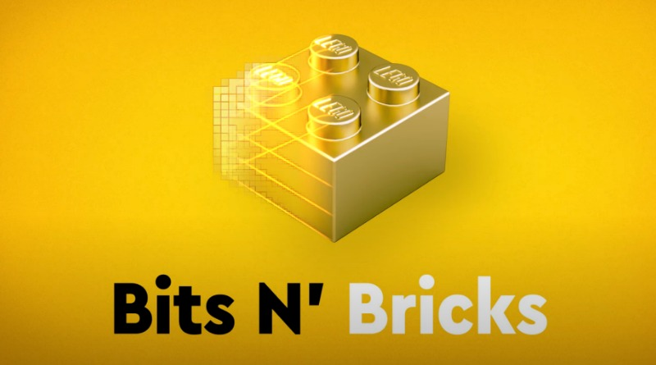
Article: “Reintroducing the Official LEGO Podcasts!”
Notes:
Hannah

Slide 15
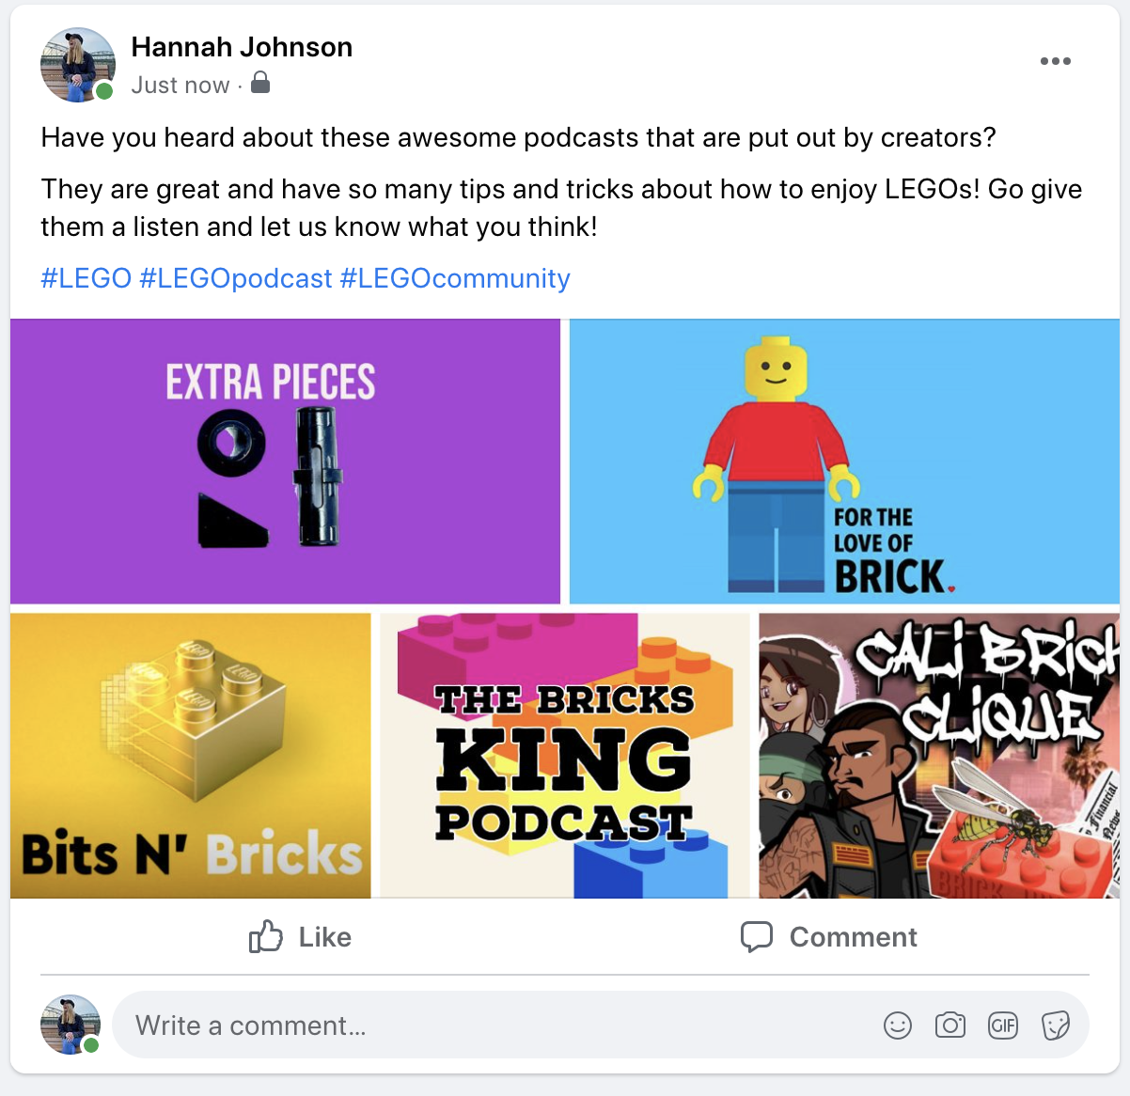
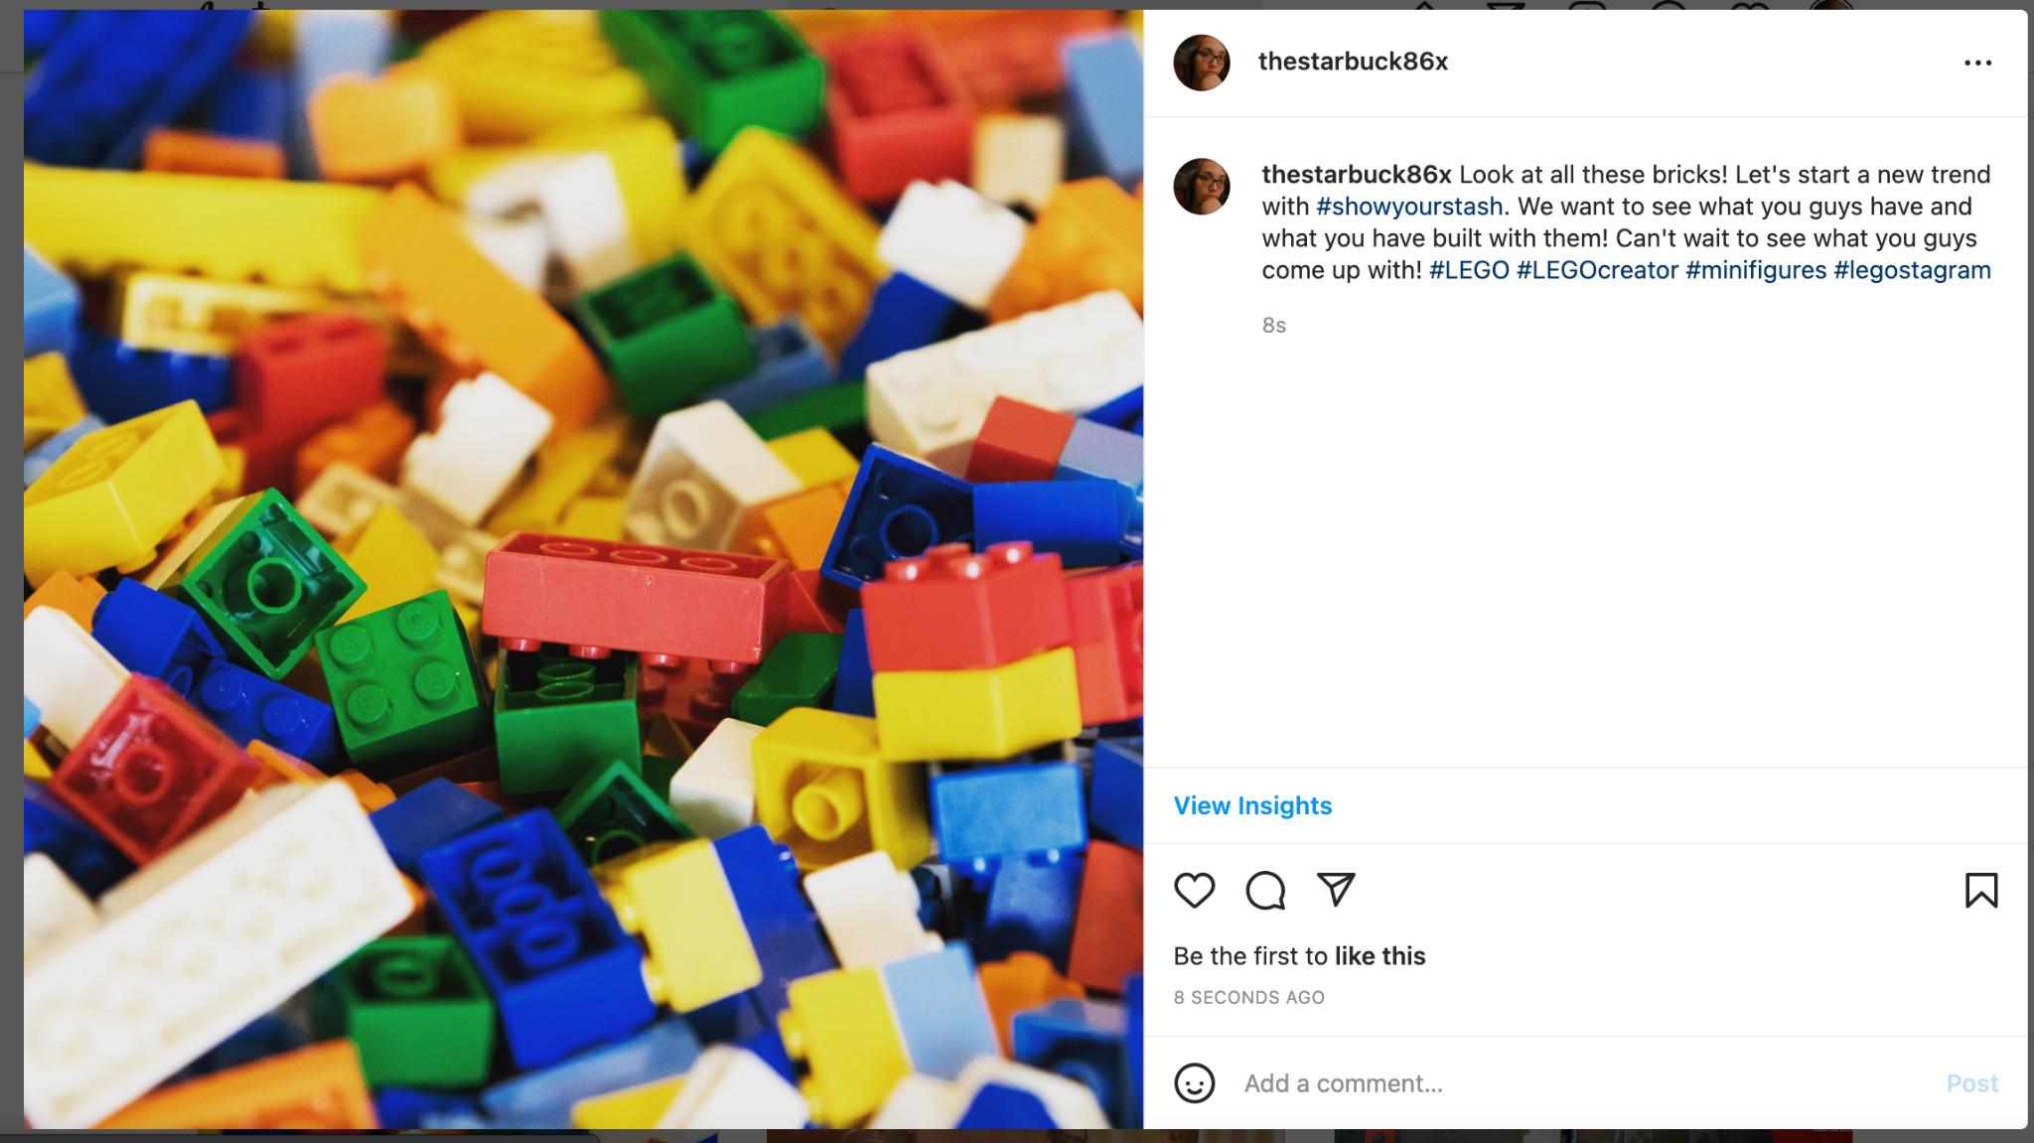
Pictures: Turned into Social Media Posts
Notes:
Charlotte

Slide 16
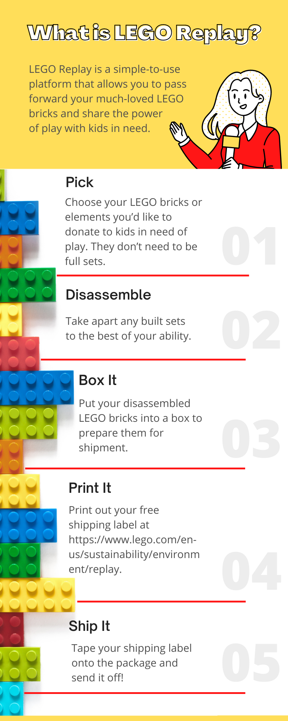
Infographic: LEGO Replay
Notes:
Kacie

Slide 17
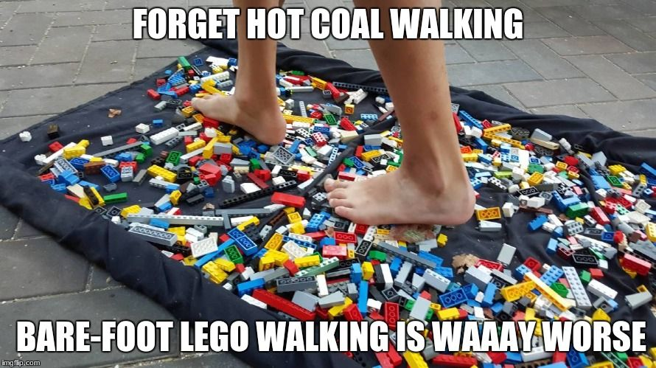
Conclusion
Thanks for listening, and may your feet be free from stepping on LEGOs!
Notes:
Briefly go over the social media campaign plan you designed for the company. What were your goals? How did you expect to reach those goals? What social media channels are you going to utilize and how? Who is your intended audience?
Amanda

